Slide 1

Module 2
RDA Basics
Recognizing and Using RDA Records
RDA Training
Harold B. Lee Library, Brigham Young University
Fall 2015

Slide 2
Please log in to RDA
http://access.rdatoolkit.org/login
Notes:
From now on, as I show slides of RDA, please feel free to go ahead and look yourself in the Toolkit.

Slide 3
RDA Record Creation (OCLC)
Create new master records in RDA (BYU: these should be PCC records)
BYU: upgrade master records to RDA (as PCC records)
Notes:
NOTE: YOU can all begin creation of RDA records if you like, as long as you follow the OCLC policies if you’re working in OCLC, and the PCC policies if you’re doing national level authority work. And you can follow whatever policy you like in your own catalog. So I encourage you to just jump in and start to swim! In the later modules we’ll talk about specifics.

Slide 4
OCLC RDA Policy
(bibliographic records)
http://www.oclc.org/rda/new-policy.en.html
  Original cataloging may be contributed in RDA
  Non-RDA master records may be upgraded to RDA
  Do not convert RDA records back to AACR2
  Some RDA elements may be added to non-RDA records without fully upgrading the record

Slide 5
The LC/NACO Authority File
No AACR2 work has been allowed in the File since March 31, 2013.
AACR2 authority records remain in the File, but most will be converted to RDA.
The file is available at:
  authorities.loc.gov
  or
  in OCLC Connexion
Notes:
It is crucial that you start cataloging in RDA now, as soon as you’re done with this workshop, so that you don’t forget what you’ve learned.

Slide 6
PCC RDA Policy
(authority records)
Original authority records must be RDA.
If any change is made to a non-RDA authority record it must be converted to RDA
  RDA elements may be added
  If the RDA authorized access point is different from AACR2, the 1XX should be changed
  The old heading is recorded in 4XX with $w nnea or $w nnea
  The record is then recoded to RDA
Notes:
NACO libraries that have been trained in RDA may now revise any authority record in the NACO authority file to RDA.

Slide 7
Major revisions to the NACO Authority File
Phase One (early summer 2012). 667 field inserted in selected records reading:
667 $a THIS 1XX FIELD CANNOT BE USED UNDER RDA UNTIL THIS RECORD HAS BEEN REVIEWED AND/OR UPDATED
Notes:
Selected records in the authority file were revised to include this 667 note. These records were records that we know the authorized access point is likely to be incorrect according to RDA guidelines, but which were not able to be changed programmatically (phase 2). The 667 is a kind of flag meaning “Think carefully about this record! It may not have a correct access point for RDA.”
Included were Conference headings; headings with more than one language or “polyglot” named in them (Homer. Iliad. English & Greek); personal names with subfield $c (e.g. for something like “poet” or “clarinetist”); treaties; certain musical work headings;

Slide 8
Major revisions to the NACO Authority File
Phase two (completed March 2013). Programmatic changes to the NACO authority file and the OCLC bibliographic file, including:
  Expand the abbreviations ‘arr.’, ‘acc.’ and unacc.’
  Modify ‘Bible’ headings
  Expand the abbreviation ‘Dept.’
  Modify ‘violoncello’ headings
  Modify ‘Koran’ headings
  Modify ‘Selections’ uniform titles
  Modify dates of persons (e.g. “b. 1850” => “1850-”)
Notes:
Some of the programmatic changes are listed here. ATTENTION!! If your library uses the NACO Authority File, you will be getting all these changes even if you aren’t a NACO participant. You will need to take steps to ensure that your bibliographic file changes in synch with the authority file.

Slide 9
Major revisions to the NACO Authority File
Phase three (in progress 2015). More programmatic changes to the NACO authority file and the OCLC bibliographic file, including:
  Changes to music medium of performance statement
  Reformulation of 678 fields not suitable for public display
  Revision of contents of 370 fields to conform to current policy
  Replacement of obsolete indicators
  Generation of 046 fields as possible
  Generation of 382 fields for some medium of performance statements
  Insertion of ISNIs (International Standard Name Identifier) into most authority records
Notes:
Some of the programmatic changes are listed here. ATTENTION!! If your library uses the NACO Authority File, you will be getting all these changes even if you aren’t a NACO participant. You will need to take steps to ensure that your bibliographic file changes in synch with the authority file.

Slide 10
How do I recognize an RDA record?
040 $e rda
Presence of new RDA elements in the record
Bibliographic records: “Desc” fixed field = i (vs. “a” for AACR2)
Authority records: “Rules” fixed field = “z” (vs. “c” for AACR2)
Notes:
And here are some examples.

Slide 11
Where can I find some examples?
In OCLC, do a command line search “dx:rda”
  You will need to limit (e.g. by date) because there are now nearly 170,000 RDA records in OCLC, too many for the search to display without limits
In the BYU Library catalog (catalog.lib.byu.edu), do a “search all” keyword search using “rda{040}”
Notes:
Please be aware that records identified in OCLC as RDA offer no guarantees!!! Some are more accurately RDA than others. But we’re all learning, so please be patient and don’t use lists like OCLC-CAT as public pillorying posts! If you have a question, just contact the library that created the record. If you do searches in the BYU catalog, again we don’t guarantee that everything is perfect, but our more recent records are more likely to be in line with current RDA practice than much you will find in OCLC.

Slide 12
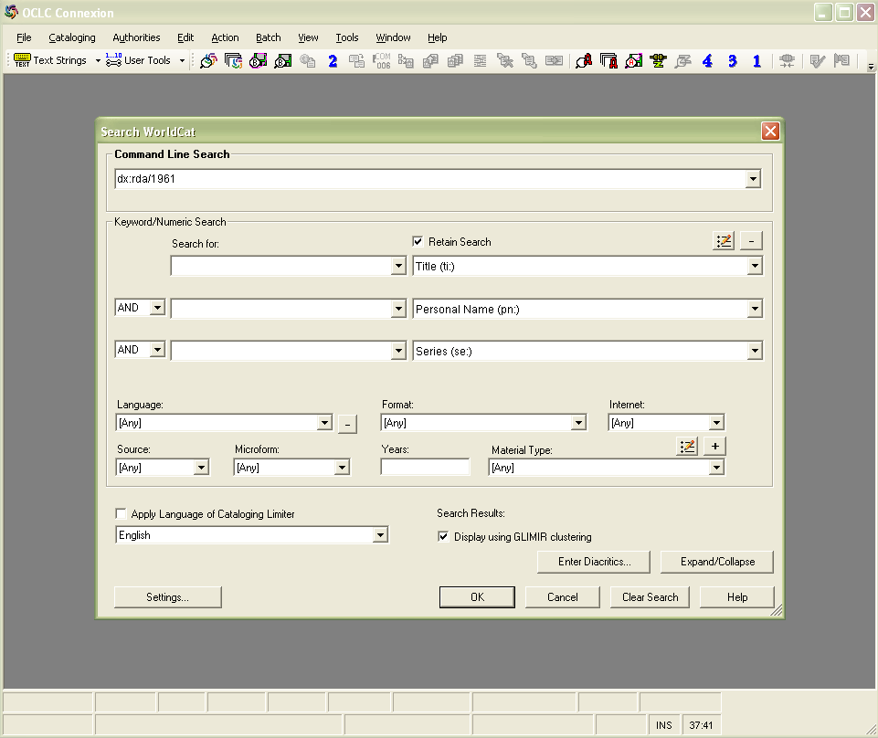
Notes:
Here is an example of an OCLC command line search for RDA records with publication date 1961. [This search was done in 2013. There are now too many RDA records for 1961 publications to pull up results. Need to add another limiter, like /bks /rec /cnr (continuing resources) /map /sco or /vis]

Slide 13
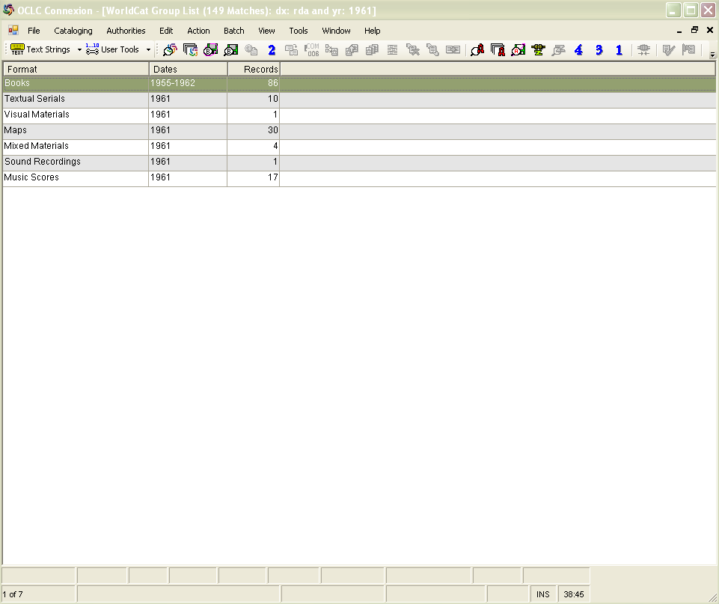

Slide 14
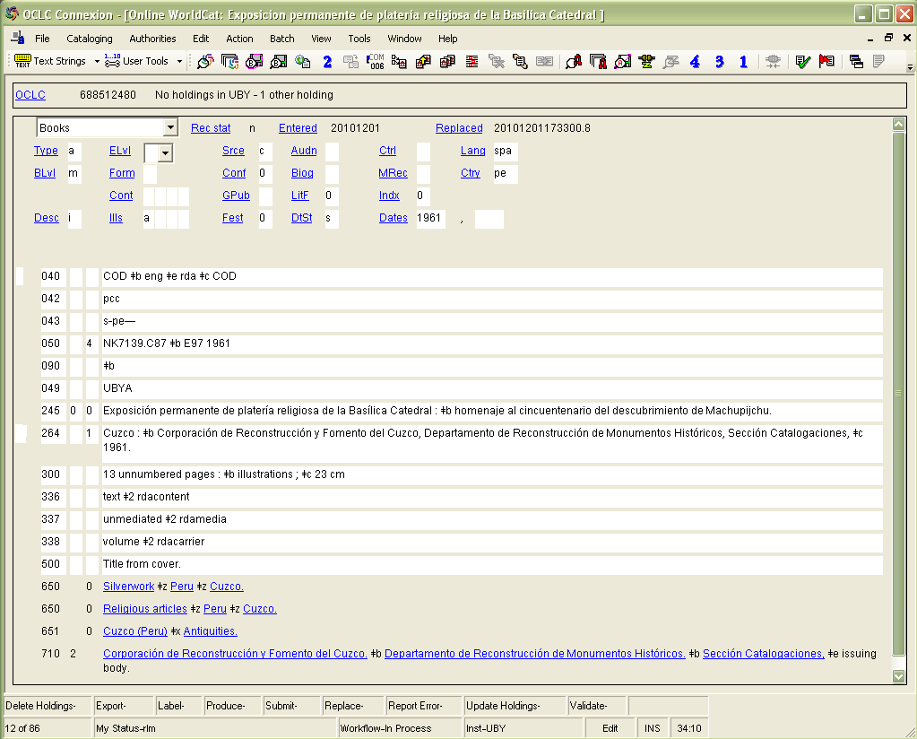
Notes:
This is an example of an RDA record created by the University of Colorado at Boulder, not one of the testing institutions. What do you notice about it that is different?
Desc
040 language of cataloging and RDA
264 (!)--the publisher’s name has not been shortened
300
336, 337, 338
710 $e

Slide 15
Notes:
RDA stuff circled

Slide 16
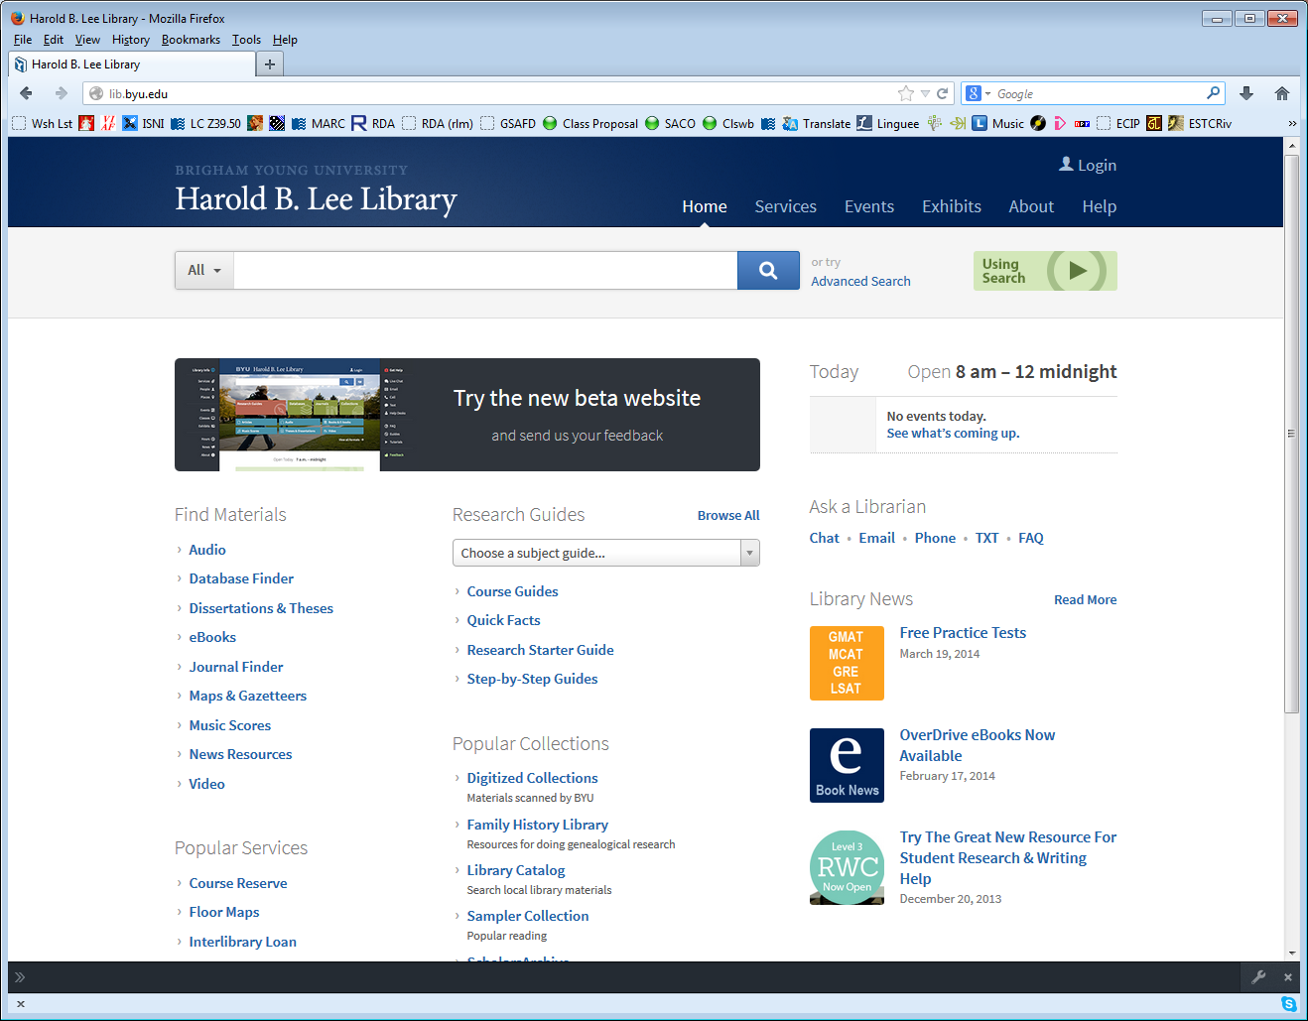

Slide 17
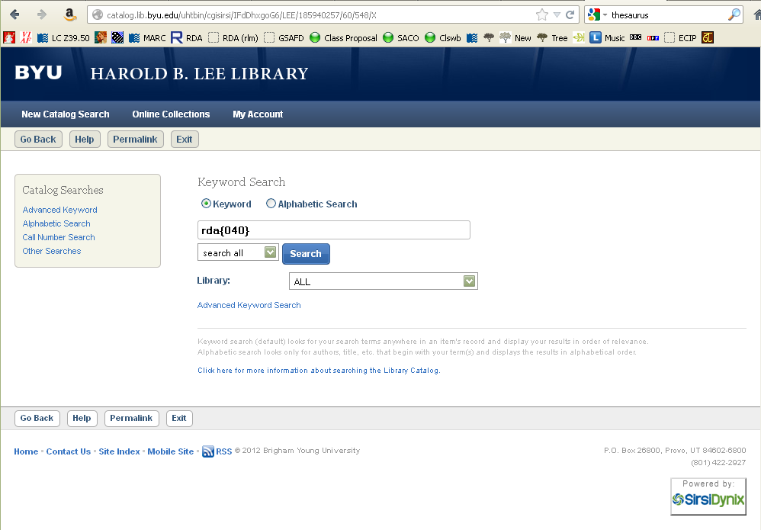

Slide 18
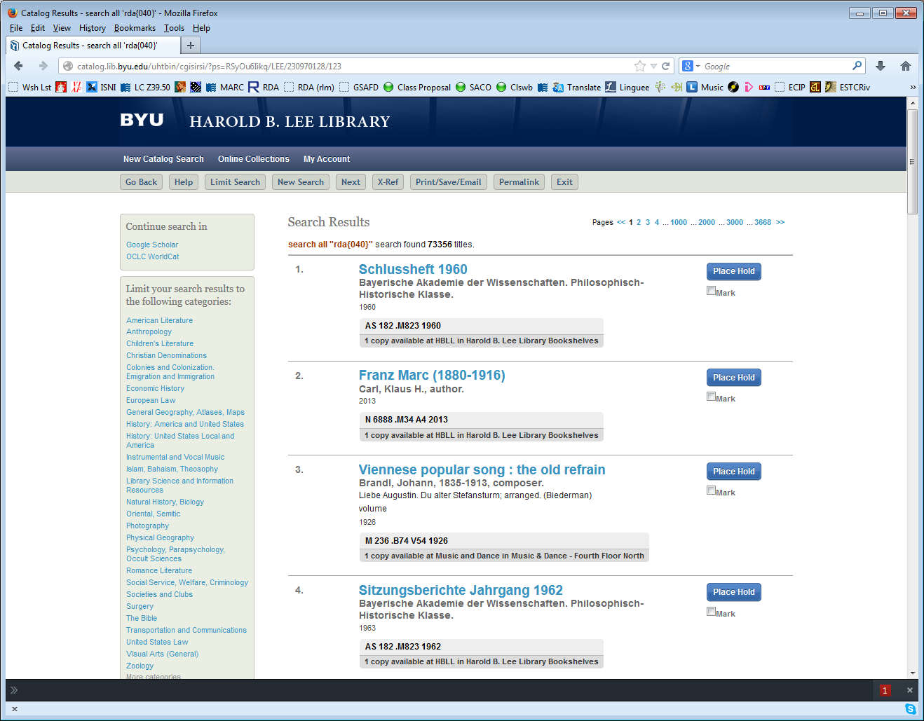
Notes:
This screen shot was taken March 29, 2014-there are now over 73,000 RDA records in the BYU catalog.

Slide 19
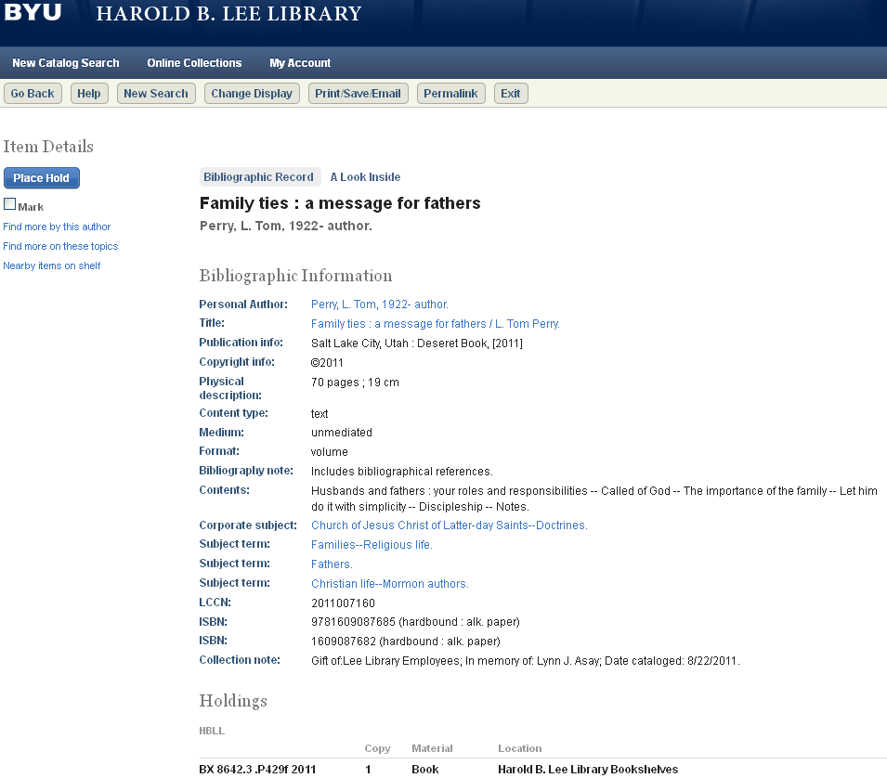
Notes:
Here’s an example of one. To see the MARC record in the BYU catalog, click on “change display”

Slide 20
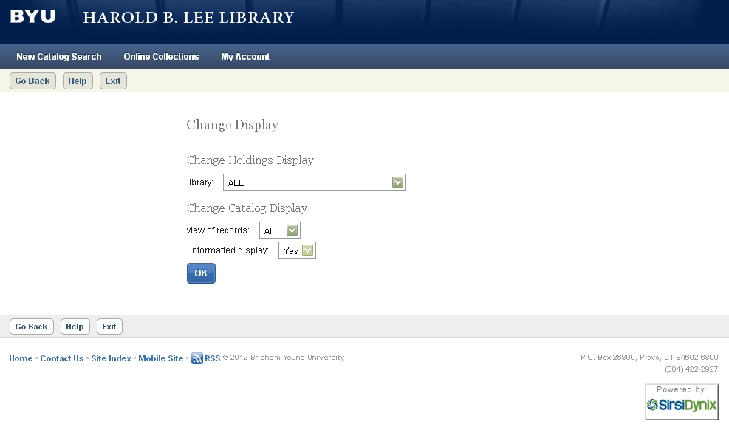
Notes:
Change the view to All and “unformatted display” to Yes.

Slide 21
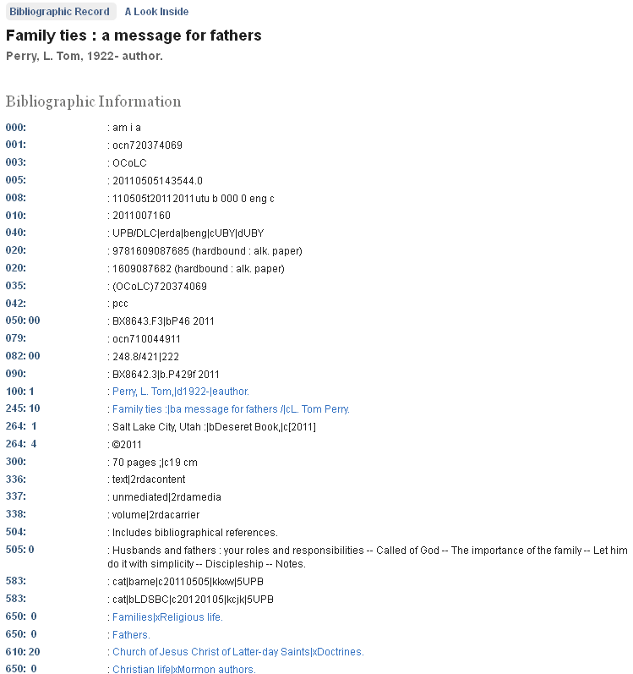
Notes:
What do you notice about this record?
100 $e
264 fields
300
336-338
Note subject analysis is exactly the same as ever--for the most part subject practice is neither AACR2 nor RDA.

Slide 22
Notes:
RDA stuff circled

Slide 23
Where can I find some examples of RDA authority records?
In Connexion, “dx:rda” in authority command line search; you can the limit search
The access points on most RDA records from BYU (OCLC symbol = UBY) are authorized by RDA authority records or AACR2 authority records with RDA elements
  Example of a bibliographic command line search to find these: “li:uby dx:rda/1960-1969”
Notes:
Or, from the record we just saw in BYU’s catalog, it is likely that the authority record for L. Tom Perry will have been updated with RDA elements.

Slide 24
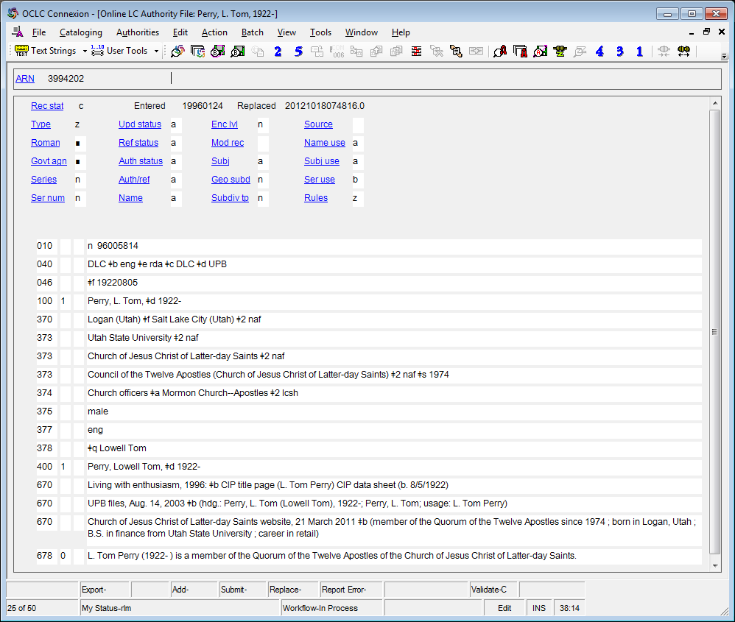
Notes:
And so it has. What do you notice about this authority record that is different from AACR2?
040 rules
046 dates
370 associated places
373 affiliation
374 occupation
375 gender
377 language
378 fuller forms

Slide 25
Notes:
RDA stuff marked

Slide 26
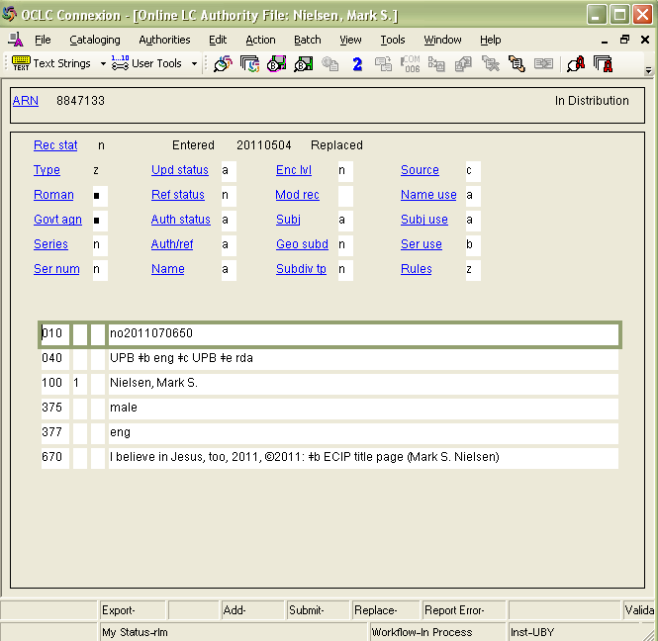
Notes:
Here’s another example, showing Rules, 040, gender, and an element we haven’t seen before, the language the person uses when creating works, in 377. This could have been included in the L. Tom Perry example. The cataloger just forgot to put it in.

Slide 27
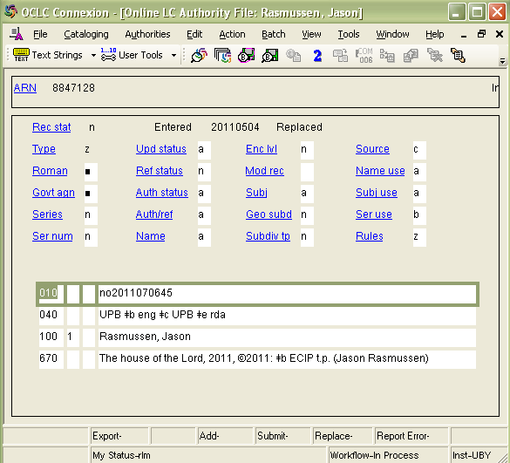
Notes:
On the other hand, an RDA authority record doesn’t HAVE to be complex. Except for the labeling of this record as RDA in 040 and Rules, there are no differences between this record and what it would have been had it been done in AACR2.

Slide 28
How can we take advantage of RDA records?

Slide 29
New Elements : Bibliographic
General Material Designation abolished, replaced by
Content Type
Media Type
Carrier Type

Slide 30
Media type
Categorization reflecting the general type of intermediation device required to view, play, run, etc., the content of a resource (RDA 3.2.1). Media type is not a core element.
audio
computer
microform
microscopic
projected
stereographic
unmediated
video
other
unspecified
Notes:
This is a complete list of the media types in RDA. We’ll go into much more detail about this in the modules covering manifestations.

Slide 31
Media type
New MARC field 337
$a audio $2 rdamedia
337 $a unmediated $2 rdamedia
This element may be repeated if there is more than one media type. This can be done either with separate 337 fields, or by repeating subfield $a in a single 337 field.

Slide 32
Carrier type
Categorization reflecting the format of the storage medium and housing of a carrier in combination with the type of intermediation device required to view, play, run, etc., the content of a resource (RDA 3.3.1). Carrier type is a core element.
A few examples (not a complete list)
audio disc
computer card
microfiche
microscope slide
film cassette
overhead transparency
stereograph card
flipchart
volume
videodisc
other
unspecified

Slide 33
Carrier type
New MARC field 338
$a videodisc $2 rdacarrier
338 $a volume $2 rdacarrier
This element may be repeated if there is more than one media type. This can be done either with separate 338 fields, or by repeating subfield $a in a single 338 field.

Slide 34
Content type
Categorization reflecting the fundamental form of communication in which the content is expressed and the human sense through which it is intended to be perceived. (RDA 6.9.1). Content type is a core element.
A few examples (not a complete list)
cartographic image
notated music
performed music
spoken word
still image
text
two-dimensional moving image
still image
three-dimensional form
other
unspecified
Notes:
cartographic image includes maps

Slide 35
Content type
New MARC field 336
336 $a notated music $2 rdacontent
336 $a spoken word $2 rdacontent
This element may be repeated if there is more than one media type. This can be done either with separate 336 fields, or by repeating subfield $a in a single 336 field.

Slide 36
GMD vs. Types in MARC
AACR2
RDA
245 10 $a Fünf Violinkonzerte $h [electronic resource] / $c Giuseppe Tartini.
300 $a 1 online resource
245 10 $a Fünf Violinkonzerte / $c Giuseppe Tartini.
300 $a 1 online resource
336 $a performed music $2 rdacontent
337 $a computer $2 rdamedia
338 $a online resource $2 rdacarrier

Slide 37
GMD vs. Types in user display
AACR2 catalog display
  Title: Crazy heart [sound recording] : original motion picture soundtrack.
RDA catalog display
  Title: Crazy heart : original motion picture soundtrack.
  Medium: audio
  Format: audio disc
  Content type: performed music
Alternately, the RDA “types” could be displayed as icons.
Notes:
So the question is, how will you display these, if you display them at all? In the BYU catalog, we have chosen for now to display them as shown here. Second, will you use them in indexing? For the moment, we have decided just to index them into our general keyword index; which, in our catalog, can be searched by specific field, so we can look for the word “audio disc”, for example, specifically in the 338 field. They could also be used as limits or facets. What will YOU do? If we just sit back and don’t do anything, we’re missing the boat and our users will be losing out on potentially huge improvements to their searching.
We don’t have time to go over all the new RDA elements in bibliographic records, but the types are among the most significant new elements. We’ll give more details on these elements in the manifestations module.

Slide 38
New Elements : Bibliographic
Relationship designators
  100 1 $a Card, Orson Scott, $e author.
  240 10 $a First meetings. $l French
  245 10 $a Ender Wiggin : $b premières rencontres / $c Orson Scott Card ; traduit de l’anglais par Florence Bury.
  700 1 $a Bury, Florence, $e translator.
Notes:
This is not strictly speaking a new practice, but it is receiving new emphasis in RDA; the relationship between entities, such as between works, or between persons and works, is crucial to RDA, and so we’ll be seeing more and more of this. We’ve already seen a couple of examples. Relationships between persons or corporate bodies and works is shown in MARC by adding a relationship term in subfield $e to an access point. In this case, we are shown explicitly that Card is the author of the work, and Bury is the translator.

Slide 39
New Elements : Bibliographic
Relationship terms
  100 1 $a Card, Orson Scott, $e author.
  245 10 $a Hidden empire / $c Orson Scott Card.
  250 $a First mass market edition.
  700 1 $i Sequel to: $a Card, Orson Scott. $t Empire.
Notes:
Relationships between works are shown by adding a relationship term in subfield i of an access point for a work.
How will you display these? How will you index them?
At the very least you need to make sure that your index does not index on the word “Sequel”. But you might want to take advantage of these relationship terms in indexing. For example,

Slide 40
Possible index display using relationship terms
Catalog browse by author:
Moser, Barbara, author. 1 hit
Moser, Barry, author. 17 hits
Moser, Barry, book designer. 5 hits
Moser, Barry, illustrator. 64 hits
Moser, Barry, signer. 1 hit
Moser, Barry, wood-engraver. 29 hits
Moser, Benjamin, author. 4 hits
Notes:
The BYU catalog posts results similar to this one when a user does an alphabetic author search. We decided to include the relationship terms in the index, which separates out the functions the person does in relation to the resource in the catalog.

Slide 41
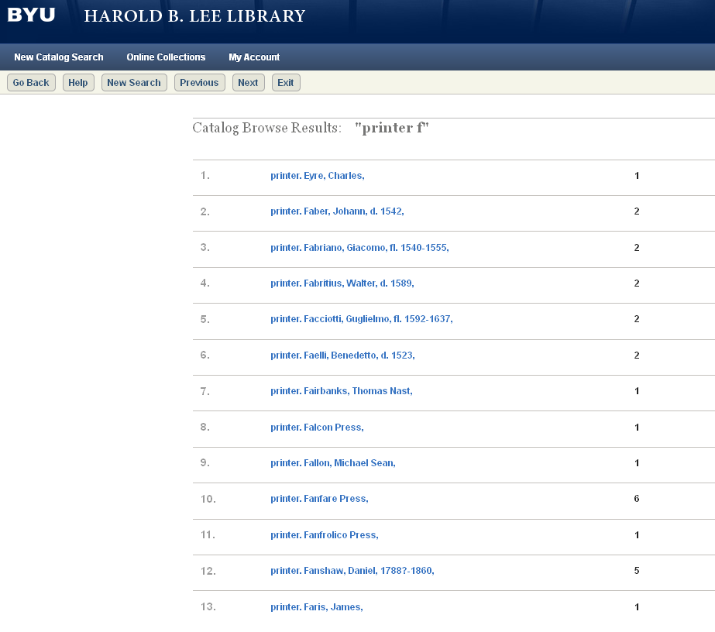
Notes:
We also use these terms to group together the functions, for example, to get a list of the printers represented in special collections. This index display is created because relationship terms have been included with the access points; they were rotated to the front by the system for the index.
You may notice that some of these authorized access points would not be valid in RDA (which ones?)
These are a few ideas of ways you could take advantage of some of the new RDA elements.

Slide 42
New Elements: Authority
Dates (046)
Content type (336)
Format of notated music (348)
Other attributes of person or corporate body (368)
Associated place (370)
Address (371)
Field of activity (372)
Affiliation (373)
Occupation (374)
Gender (375)
Family info (376)
Language (377)
Fuller form of personal name (378)
Form of work (380)
Other characterisitcs of work or expression (381)
Medium of performance (382)
Musical work number (383)
Key of musical work (384)
Audience characteristics (385)
Creator/contributor characteristics (386)
Time period of creation (388)
Notes:
In the authority format there are a lot of new elements, some of which we’ve seen. Currently most of our systems cannot keyword search the contents of authority records, but would it be worth pressing our vendors to implement that? You CAN search these by keyword in OCLC. It seems to me it would be useful to our users to be able to pull out, for example, all persons in our catalog who are women (using the gender element) poets (using the occupation element) who write in Spanish (using the language element). This would be possible if we could perform keyword searches on authority records AND if we have consistently coded the information in them. Think about what you might want to do with this information, and how it could help your users even if we can’t convince our vendors to make it searchable.

Slide 43
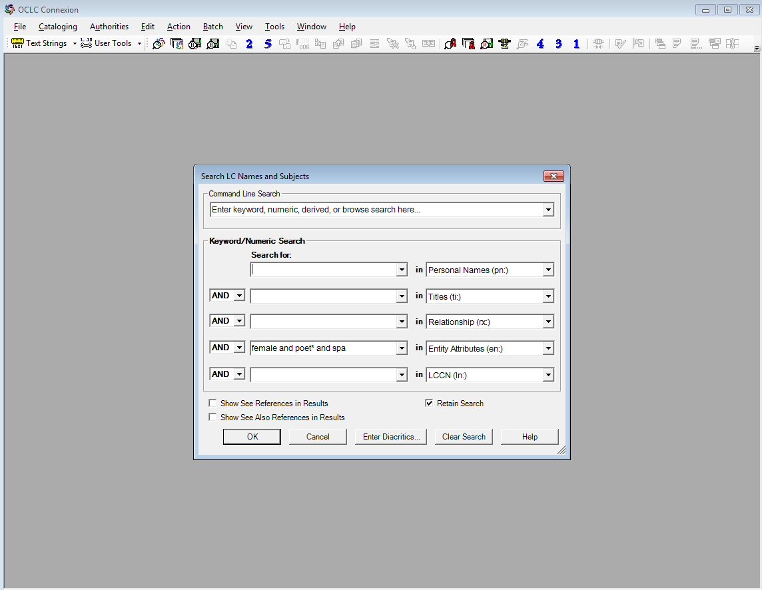
Searching by attribute in OCLC AF
Notes:
Choose the keyword authorities search; enter the attributes you want to search; choose the entity attributes search. Remember that this is a keyword search and most of these vocabularies aren’t controlled (yet).

Slide 44
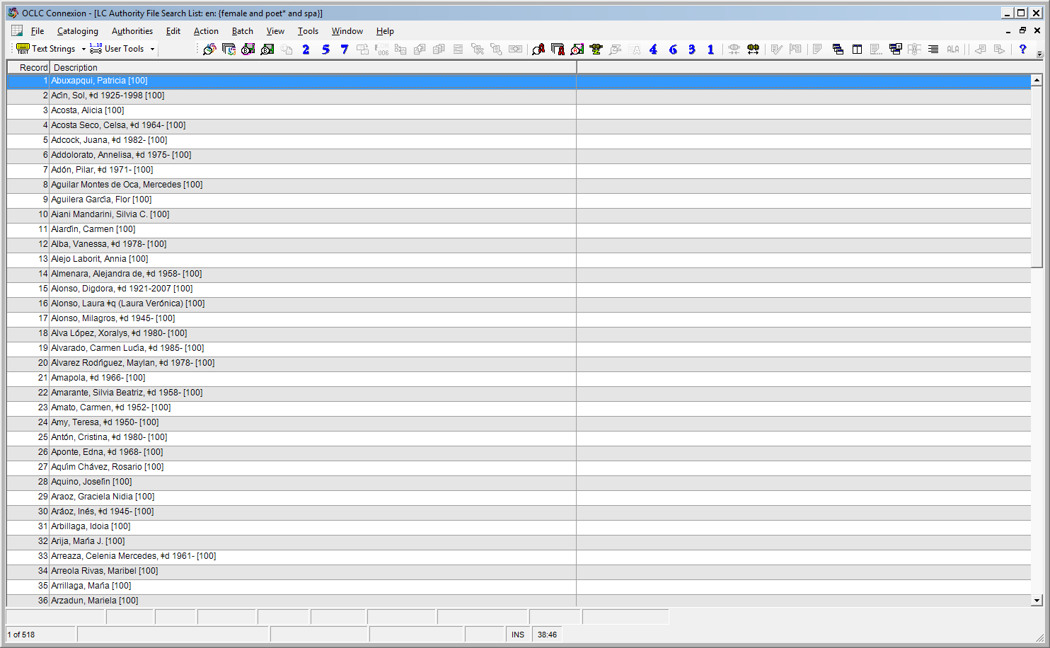
Notes:
There are currently 518 results for our search. There should probably be thousands, but we’re just starting ...

Slide 45
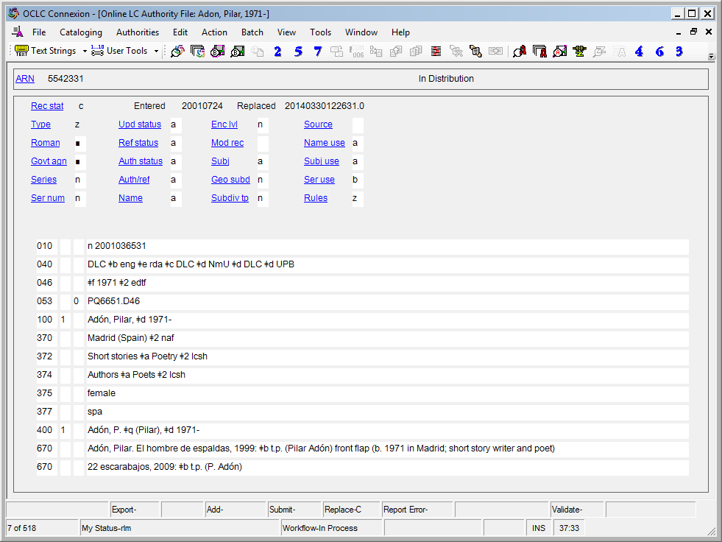
Notes:
Here’s the authority record for one of them. I’ve circled the keywords the search picked up.

Slide 46
New Practices
Very few abbreviations
Publisher statements fully transcribed
Elimination of “rule of three”
  More names will appear in title page transcriptions
  Potentially, more names will be given access points in the record
Notes:
There are a number of new practices that will be followed in RDA, including these. How will you take advantage of these in your catalog to help your users find what they want?

Slide 47
New Vocabulary
AACR2 RDA
Heading Authorized access point
Main entry Principal creator
Title main entry (no equivalent)
Added entry Access point
See reference Variant access point
Uniform title Preferred title, also
Authorized access point for a work or expression

Slide 48
New Vocabulary
AACR2 RDA
(no equivalent) Element (= FRBR’s attribute)
(no equivalent) FRBR terms such as expression
manifestation
user tasks

Slide 49
RDA Terminology Quiz

Slide 50
Module 2
RDA Basics
Recognizing and Using RDA Records
RDA Training
Harold B. Lee Library, Brigham Young University
Fall 2015

Slide 51
This Presentation is available at
http://net.lib.byu.edu/~catalog/people/rlm/RDAUtah201511/index.htm
For further information
contact Robert L. Maxwell
robert_maxwell@byu.edu

